Slide 1
Lecture 19: Database design for Scalable system
Mia Mohammad Imran

Slide 2
Question: Which is the most frequent DB operation?
Question: Which one is the most time consuming?
Question: To make the system faster, then what should you priority?
Create
Read
Write
Delete

Slide 3
To make the system faster, what you do?
For Read operations
do Indexing, as much as possible (efficient indexing that is)
Avoid SELECT *, unnecessary joins, or subqueries
Use caching layers: In-memory caches (e.g., Redis, Memcached) store frequently accessed data
In case of Write:
batch operations
asynchronous writing
Partition or shard data
reduce indexing!
(CONFLICT WITH HOW TO MAKE READ FAST)

Slide 4
What do you think about having Read operations in one DB and Write in another DB?

Slide 5
A summary of Layered System Architecture
Layer | Responsibility | Example Components
Presentation Layer | Handles user interaction | Mobile app (iOS, Android), web app
API Gateway | Routes user requests to correct services | NGINX, API Gateway, CloudFront
Application / Service Layer | Core business logic (e.g., matching drivers) | Microservices (Driver, Rider, Trip, Payment)
Data Layer | Storage, caching, search | PostgreSQL, Redis, Elasticsearch, MySQL
Infrastructure Layer | Deployment, scaling, health | Kubernetes, AWS EC2, Docker, Terraform

Slide 6
What is Cohesion in Database Design?
Cohesion refers to how closely the elements within a module or table are related
A low-cohesion database splits a logical entity into multiple smaller, independent tables
This design sacrifices entity encapsulation for modularity, flexibility, or distribution
High cohesion = one table fully represents a concept.
Low cohesion = one concept is spread across multiple tables.
One of the main reason for any API call to have high latency is that
Dependency on another table
Having JOIN options
Avoid them, you system would be faster

Slide 7
Schema Design Steps:
Assume you are developing a e-commerce platform
Step 3: Establish Link Tables
Create a repository linking table that binds entities WITHOUT using foreign keys.
Design in a way you don’t need to use JOIN operations (as less as possible)
Step 1: Identify Core Entities
Start with high-level domain objects such as:
User
Order
Product
Repository
When in doubt create more tables!
And not FOREIGN keys nor JOIN operations
Step 2: Define Independent Responsibilities
Break apart tightly bound data.
User details belong in user
Order facts belong in orders
Relationships go to order_repo

Slide 8
Design Principles for Low-Cohesion
Principle 1: Split Responsibilities
-- order table: only stores order data
CREATE TABLE order_data (
order_id INT PRIMARY KEY,
amount DECIMAL(10, 2)
….. Other relevant information);
-- storing products
CREATE TABLE order_product (
order_id INT PRIMARY KEY,
product_id VARCHAR(32) PRIMARY KEY,
count INT
);
-- mapping table: who has what
CREATE TABLE order_repo (
order_id INT PRIMARY KEY,
user_id INT PRIMARY KEY
);
Principle 2: Use Mapping Tables
Mapping tables hold relationships but no business logic.
order_repo maps user_id to order_id
Acts as a link table (sometimes called a bridge table)
Enables many-to-many or ownership patterns
CREATE TABLE user (
user_id INT PRIMARY KEY,
username VARCHAR(50)
….. Other relevant information);
CREATE TABLE product (
product_id INT PRIMARY KEY,
product name VARCHAR(50)
….. Other relevant information);
Principle 3: Avoid Overloading Tables
Don’t mix unrelated fields into the same table even if they seem convenient.
Keep user_email in user
Keep order_date in order_data
Keep ownership in order_repo

Slide 9
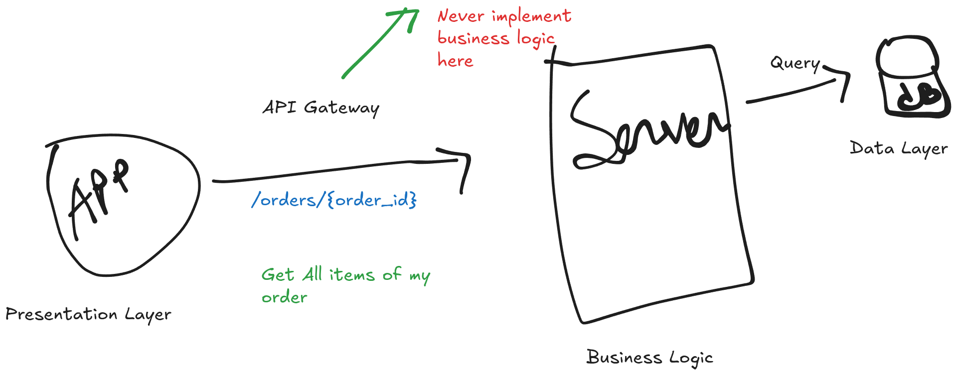
Integrating Low-Cohesion Database

Slide 10
Integrating Low-Cohesion Database
Steps:
The order exists (order table).
The user exists (user table).
The order belongs to that user (validated via order_repo).
The order has products (order_product).
Each product’s details exist in the product table.
At which layer you do it?
Layer
Presentation Layer
API Gateway / Edge Layer
Application / Service Layer
Data Layer
Infrastructure Layer

Slide 11
Integrating Low-Cohesion Database on Service Layer
Steps:
The order exists (order table).
The user exists (user table).
The order belongs to that user (validated via order_repo).
The order has products (order_product).
Each product’s details exist in the product table.
@app.get("/orders/{order_id}")
def get_order(order_id, user_id):
# Step 1: Validate existence
validate_order(order_id)
validate_user(user_id)
validate_relationship(order_id, user_id)
# Step 2: Fetch related data
items = get_order_items(order_id)
# Step 3: Assemble full response
return assemble_response(order_id, items)

Slide 12
{
"order_id": 105,
"order_date": "2025-10-30 11:20:00",
"status": "Delivered",
"total": 799.99,
"user_id": 7,
"items": [
{
"product_id": 501,
"name": "Bluetooth Headphones",
"price": 299.99,
"quantity": 1,
"subtotal": 299.99
},
{
"product_id": 502,
"name": "Smartwatch",
"price": 500.00,
"quantity": 1,
"subtotal": 500.00
}
]
}

Slide 13
Key Benefits
Data modularity: Every table can live in a separate service or database.
  Monolithic architecture/microservice either way, it works
Integrity by logic: All checks are performed at the service layer.
  Business logic has more control, easy to change than lets say database tables
Auditability: Each lookup is explicit and logged.
Scalability: No join overhead, works well in sharded environments.

Slide 14
When having too much low cohesive not good?
Consider any App you use, which are some features you have seen to take long time to load?
Trade-offs
Split too far -> Transaction failures or inconsistent state
Data fragmented -> Slow aggregation queries
Excessive mapping tables -> High query overhead

Slide 15
When having too much low cohesive not good?
Payment system
High transactions

Slide 16
What’s the idea then to make Software secure as well as fast enough where you need both kind of features (e.g., payment/analytics as well as notifications, authentication, etc)?

Slide 17
When to Use Low Cohesion vs High Cohesion
Use High Cohesion When:
  Building normal application databases (Online Transaction Processing - OLTP)
  You need clean structure and easy maintenance
  You want clear responsibilities and fewer bugs
Use Low Cohesion When:
  Building analytics/reporting systems (Online Analytical Processing - OLAP)
  Using denormalized or “wide” tables for speed
  Storing logs, events, or cache tables

